Slide 1
BPH Web site
PINE Center
Louis S. Liou

Slide 2
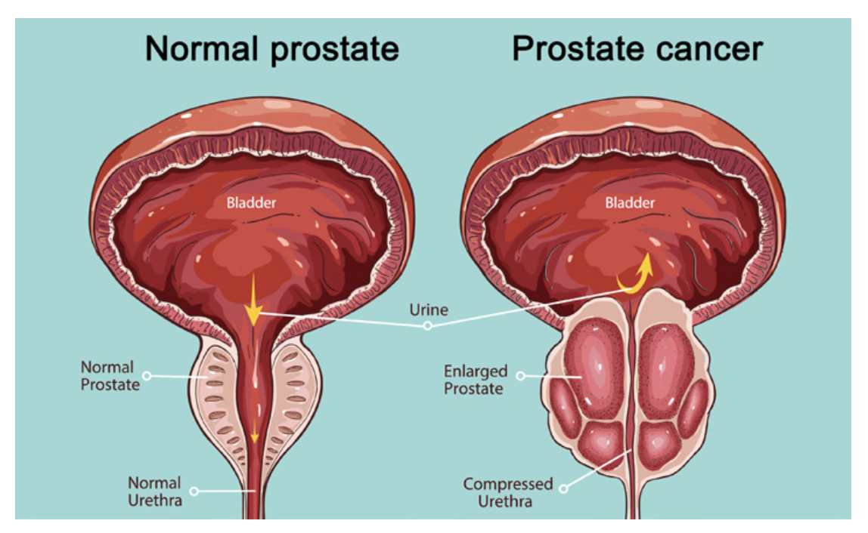
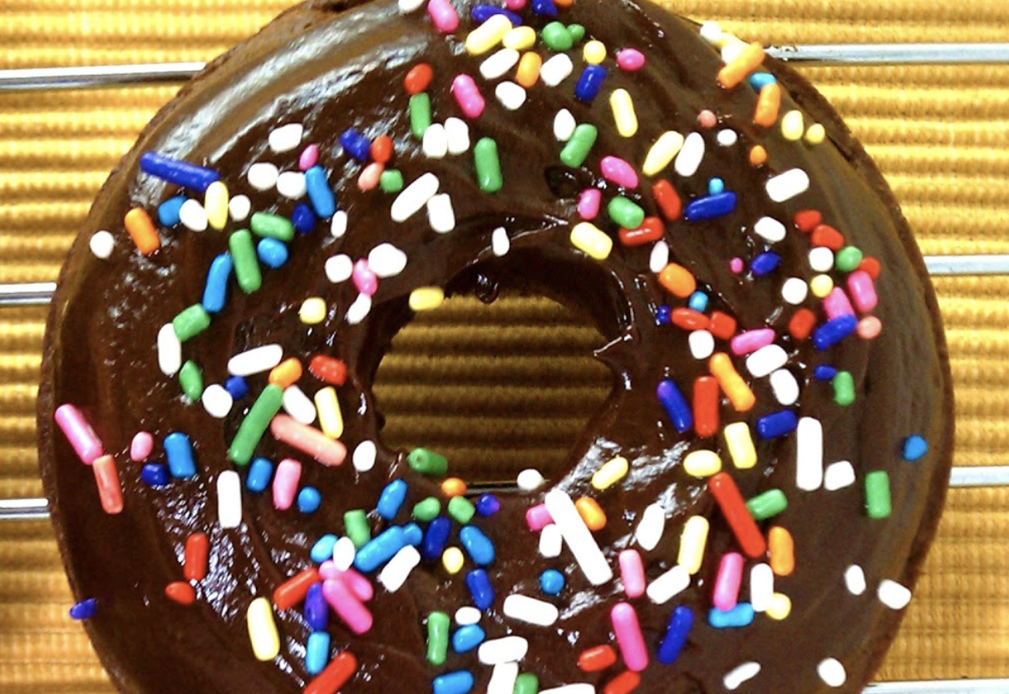
Benign Prostatic Hyperplasia (BPH)
Not Benign and enlargement is not always the key factor but obstruction (donut versus donut hole)
Benign Prostatic Hyperplasia
Notes:
BPH, not benign and not really related to the prostate size and sometimes not even the prostate.

Slide 3
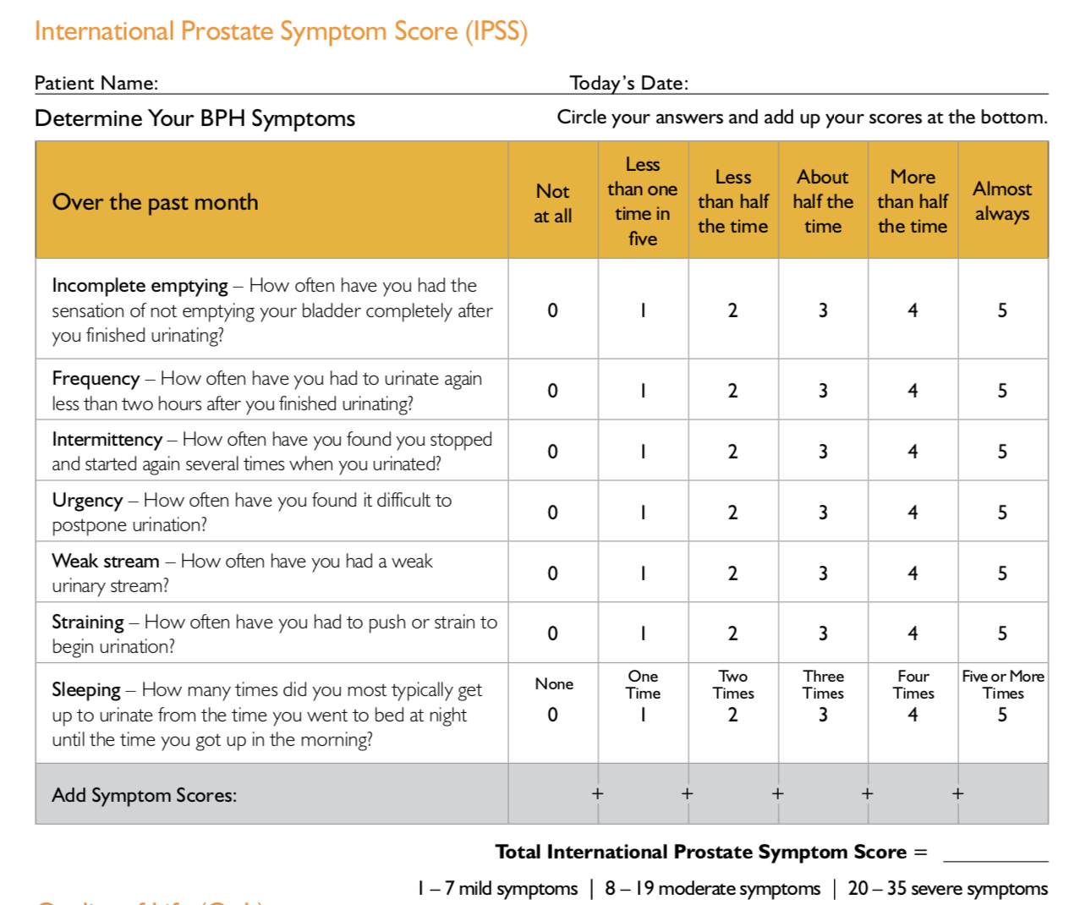
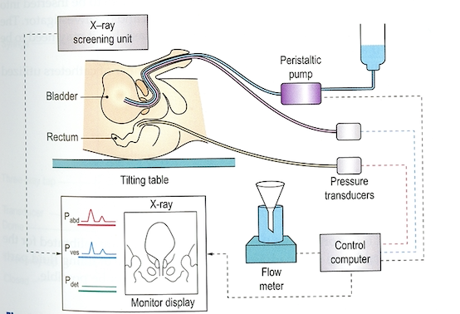
IPSS (International Prostate Symptom Score)
Approaches to Diagnose the Problem- Urodynamics (UDS) AND Cystoscopy

Slide 4
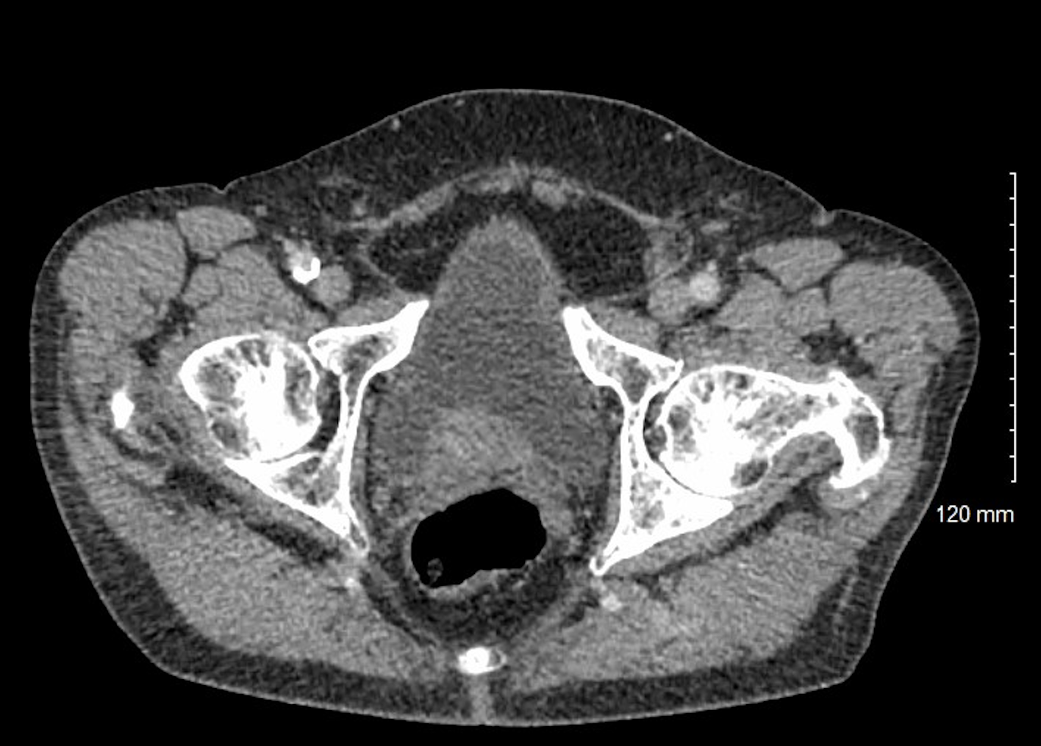
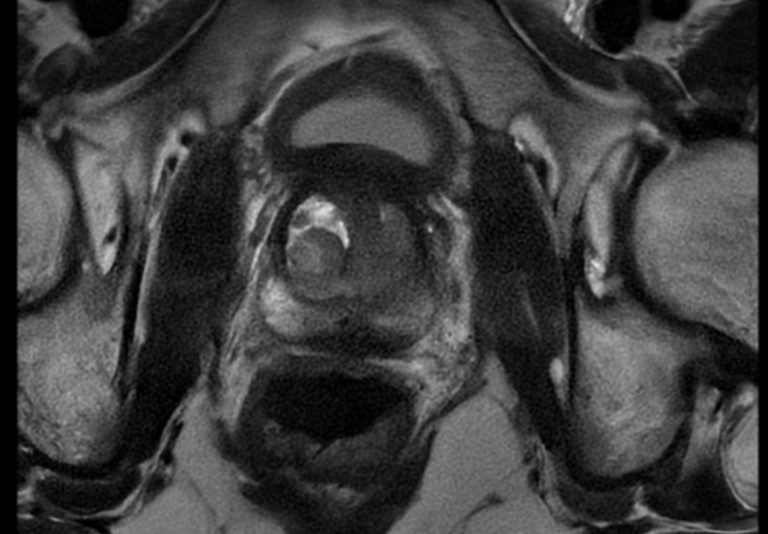
MRI Imaging
Median lobe
Transitional Zone- BPH Nodules

Slide 5
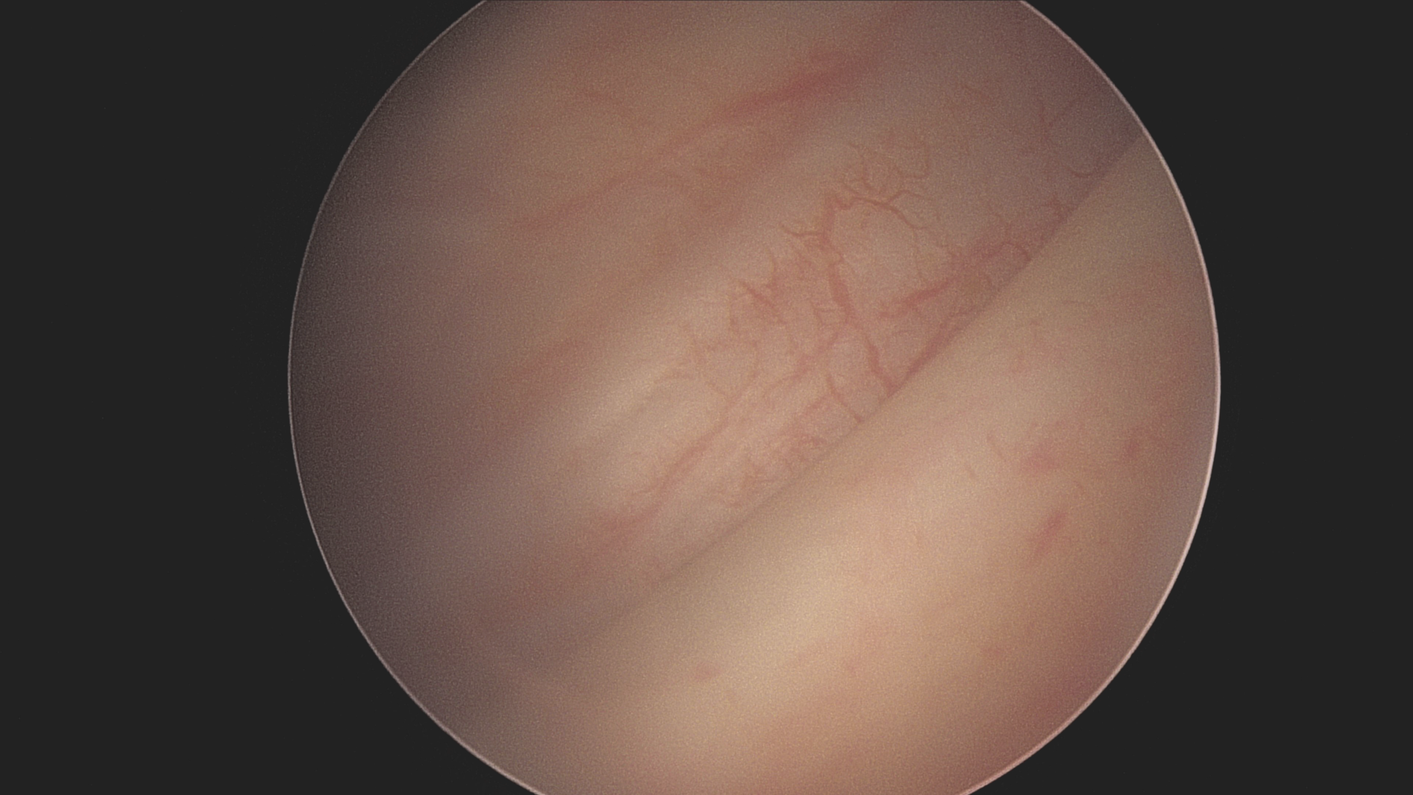
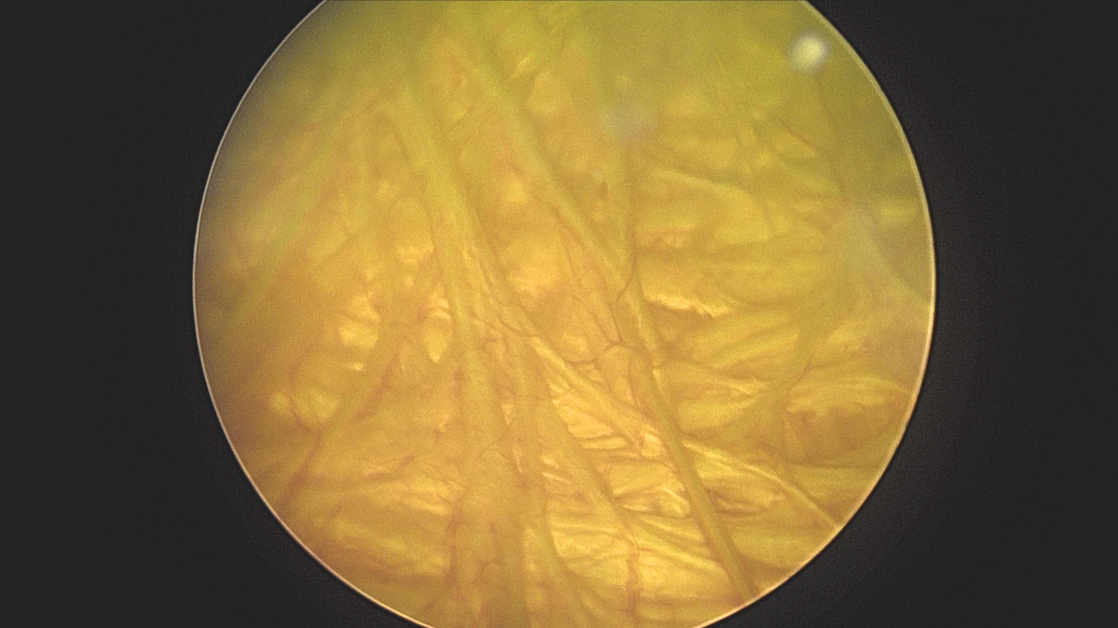
Detrusor Muscle Reaction to Obstruction
Normal Bladder
Severe Bladder Blockage

Slide 6
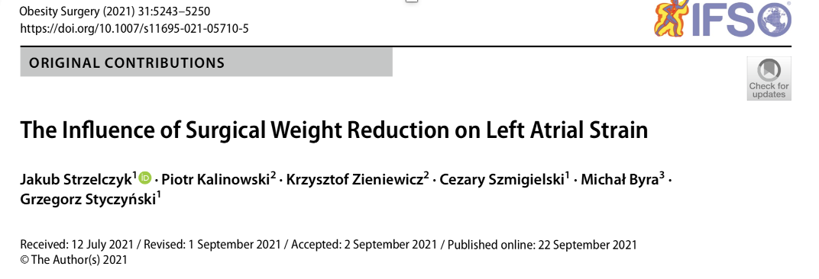
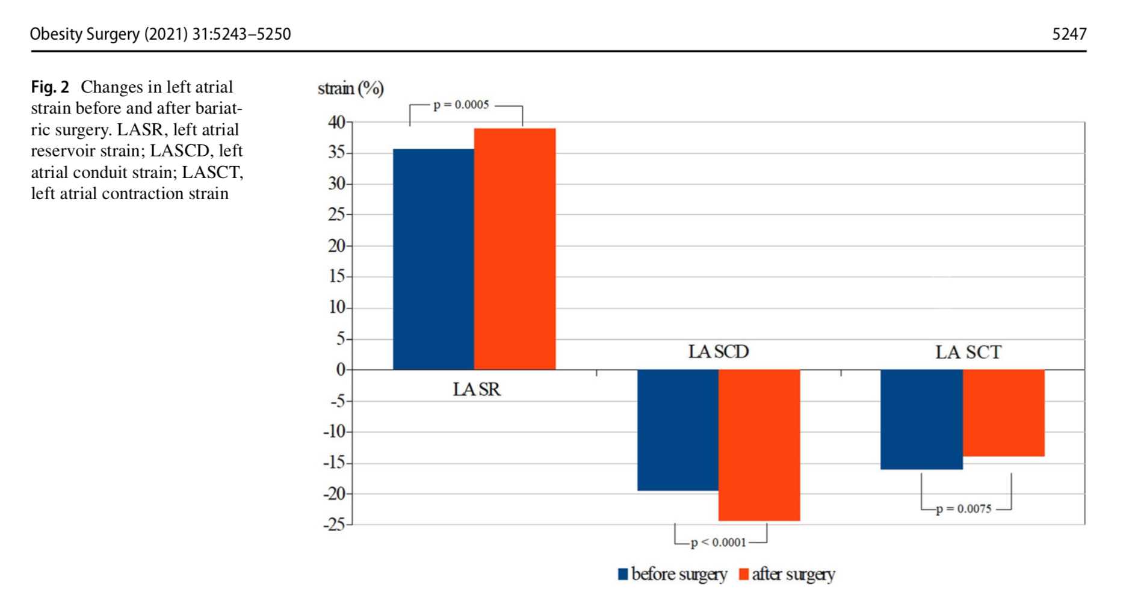
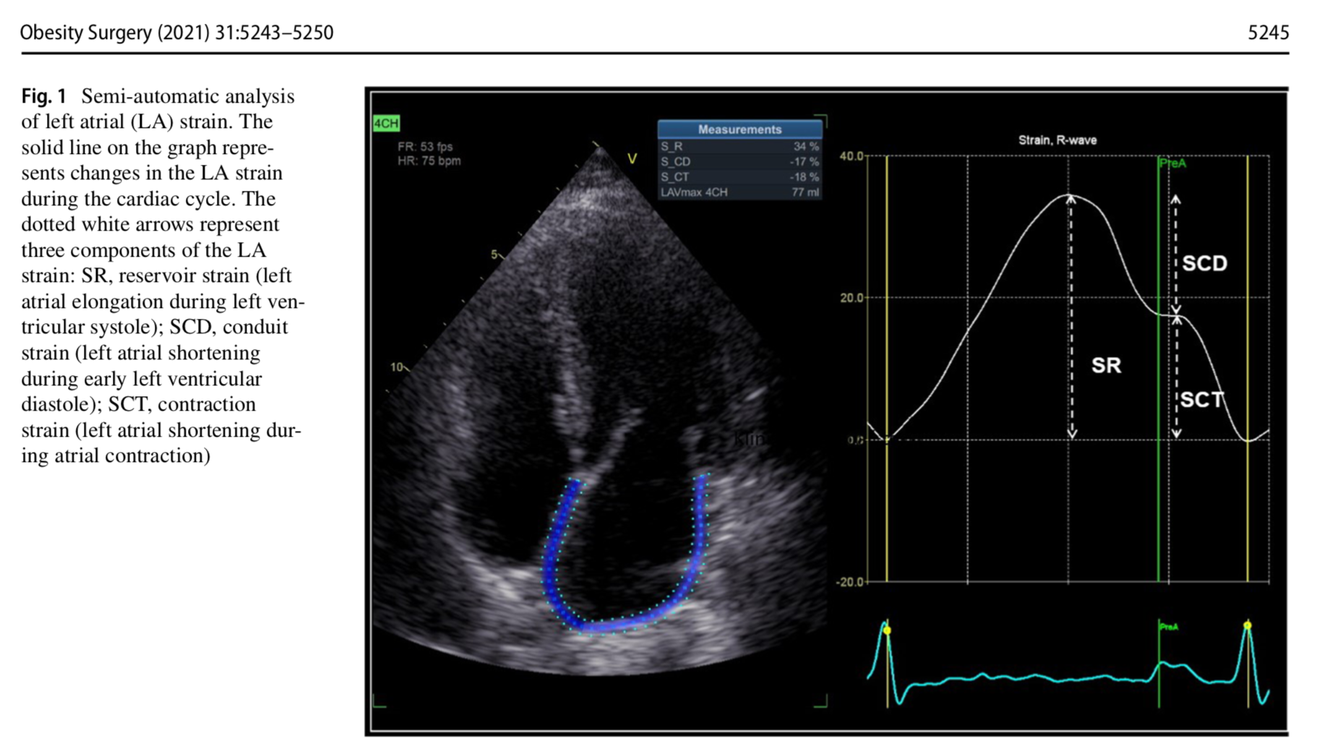
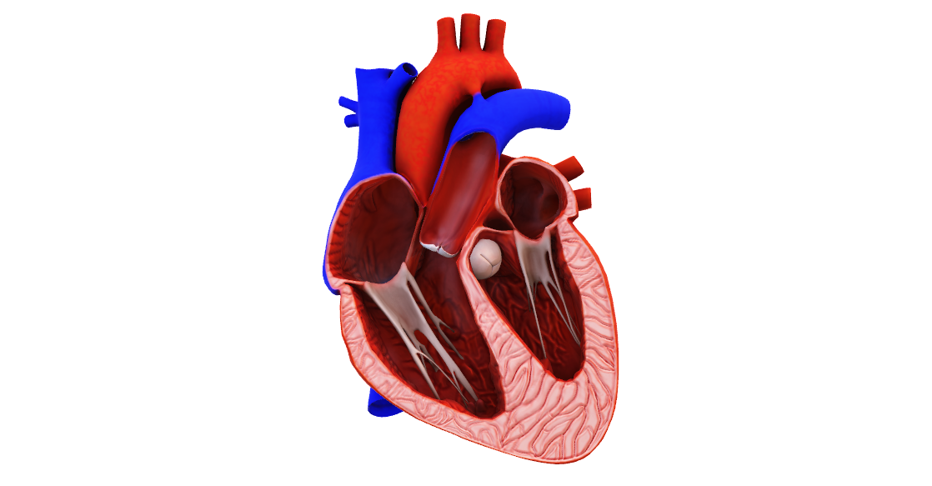
Analogous to Heart Function

Slide 7


Making a Bigger Doughnut Hole
Prior to Treatment- Obstructed
After Treatment- Non obstructed

Slide 8
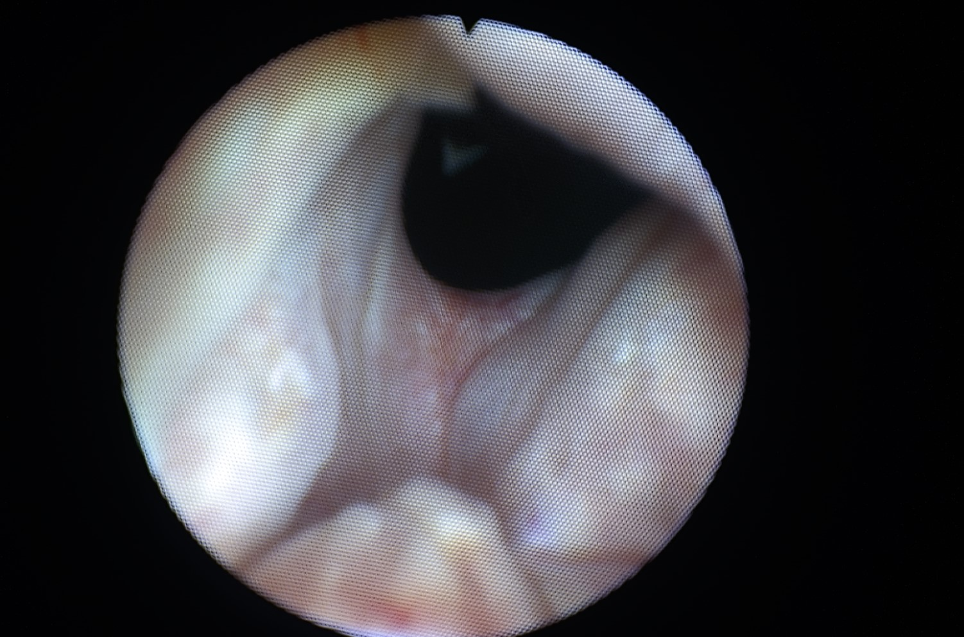
Laser Treatment of Prostate Obstruction

Slide 9
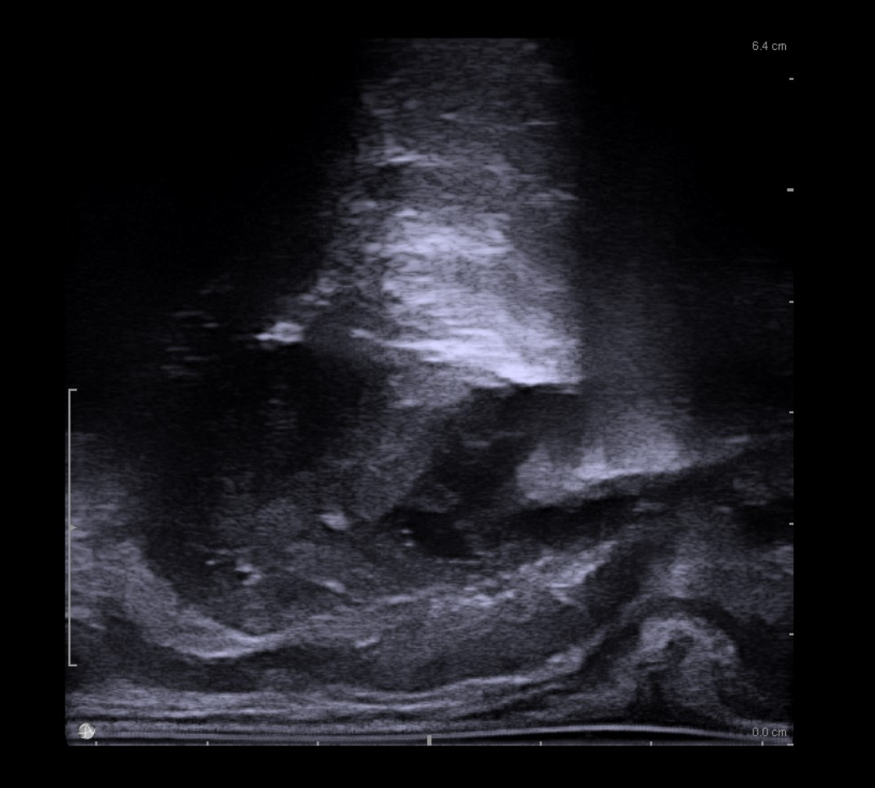
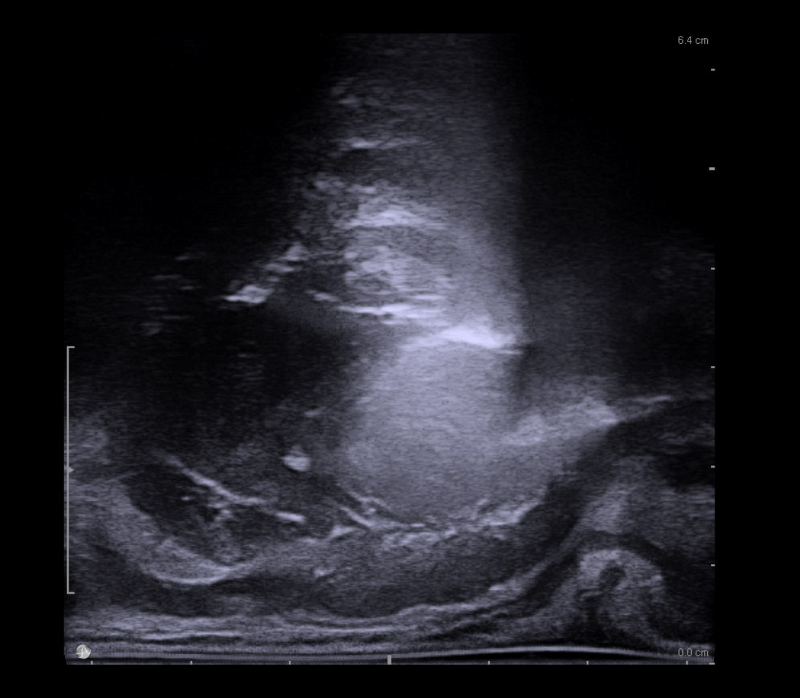
Water Vapor Treatment
Pre Treatment
During Treatment

Slide 10
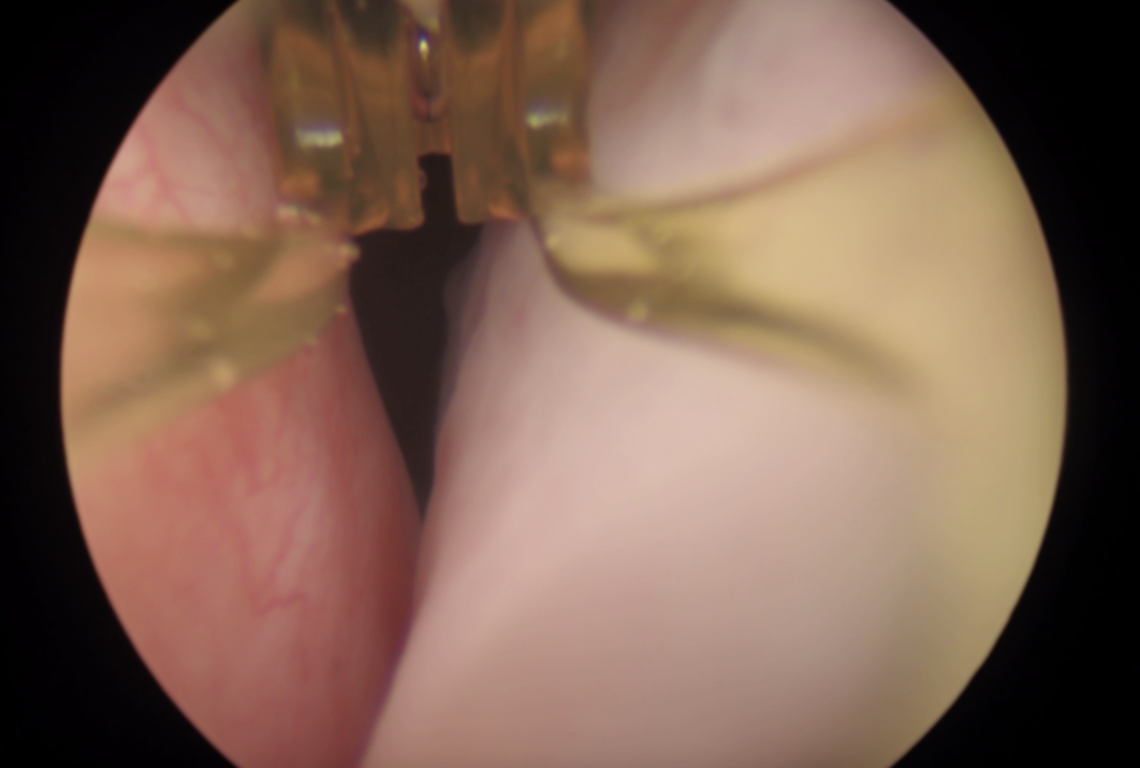
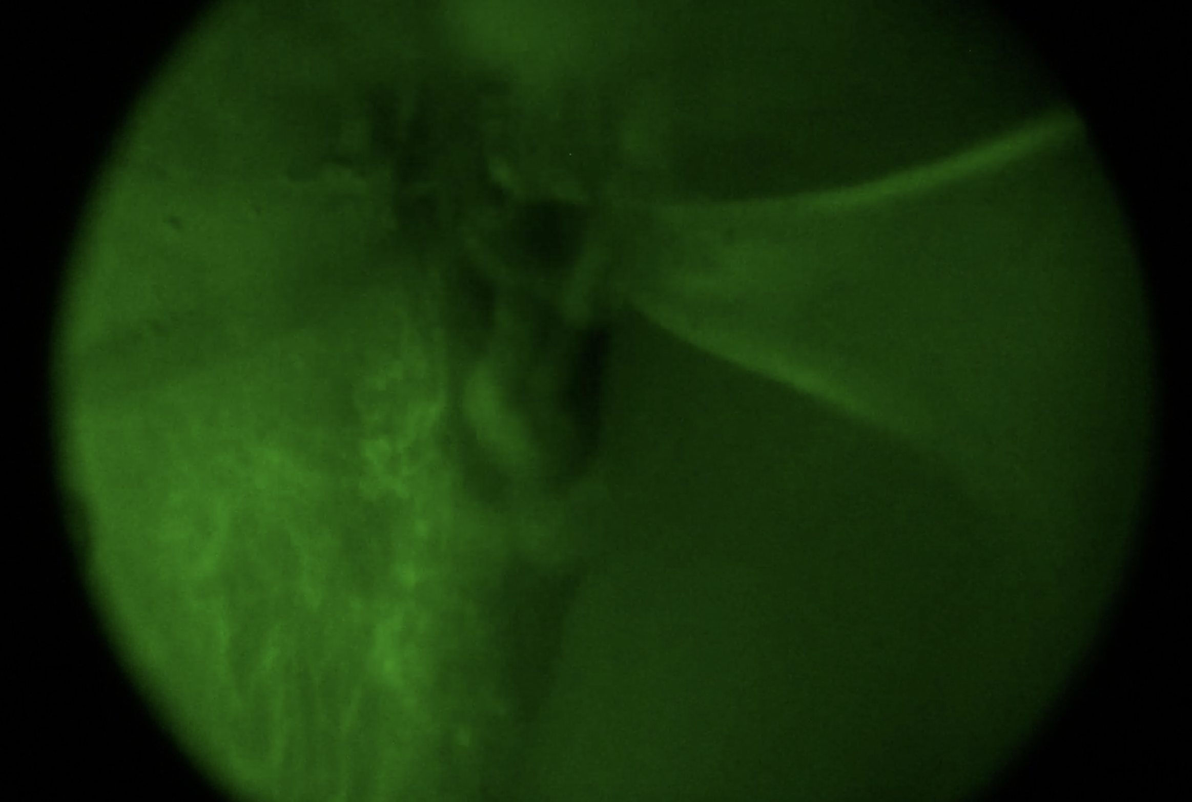
Indo Cyanine Green (ICG) Infusion Post Treatment At 30 seconds
Right Lobe untreated/ Left Lobe Treated
ICG Perfusion post Treatment on Left

Slide 11
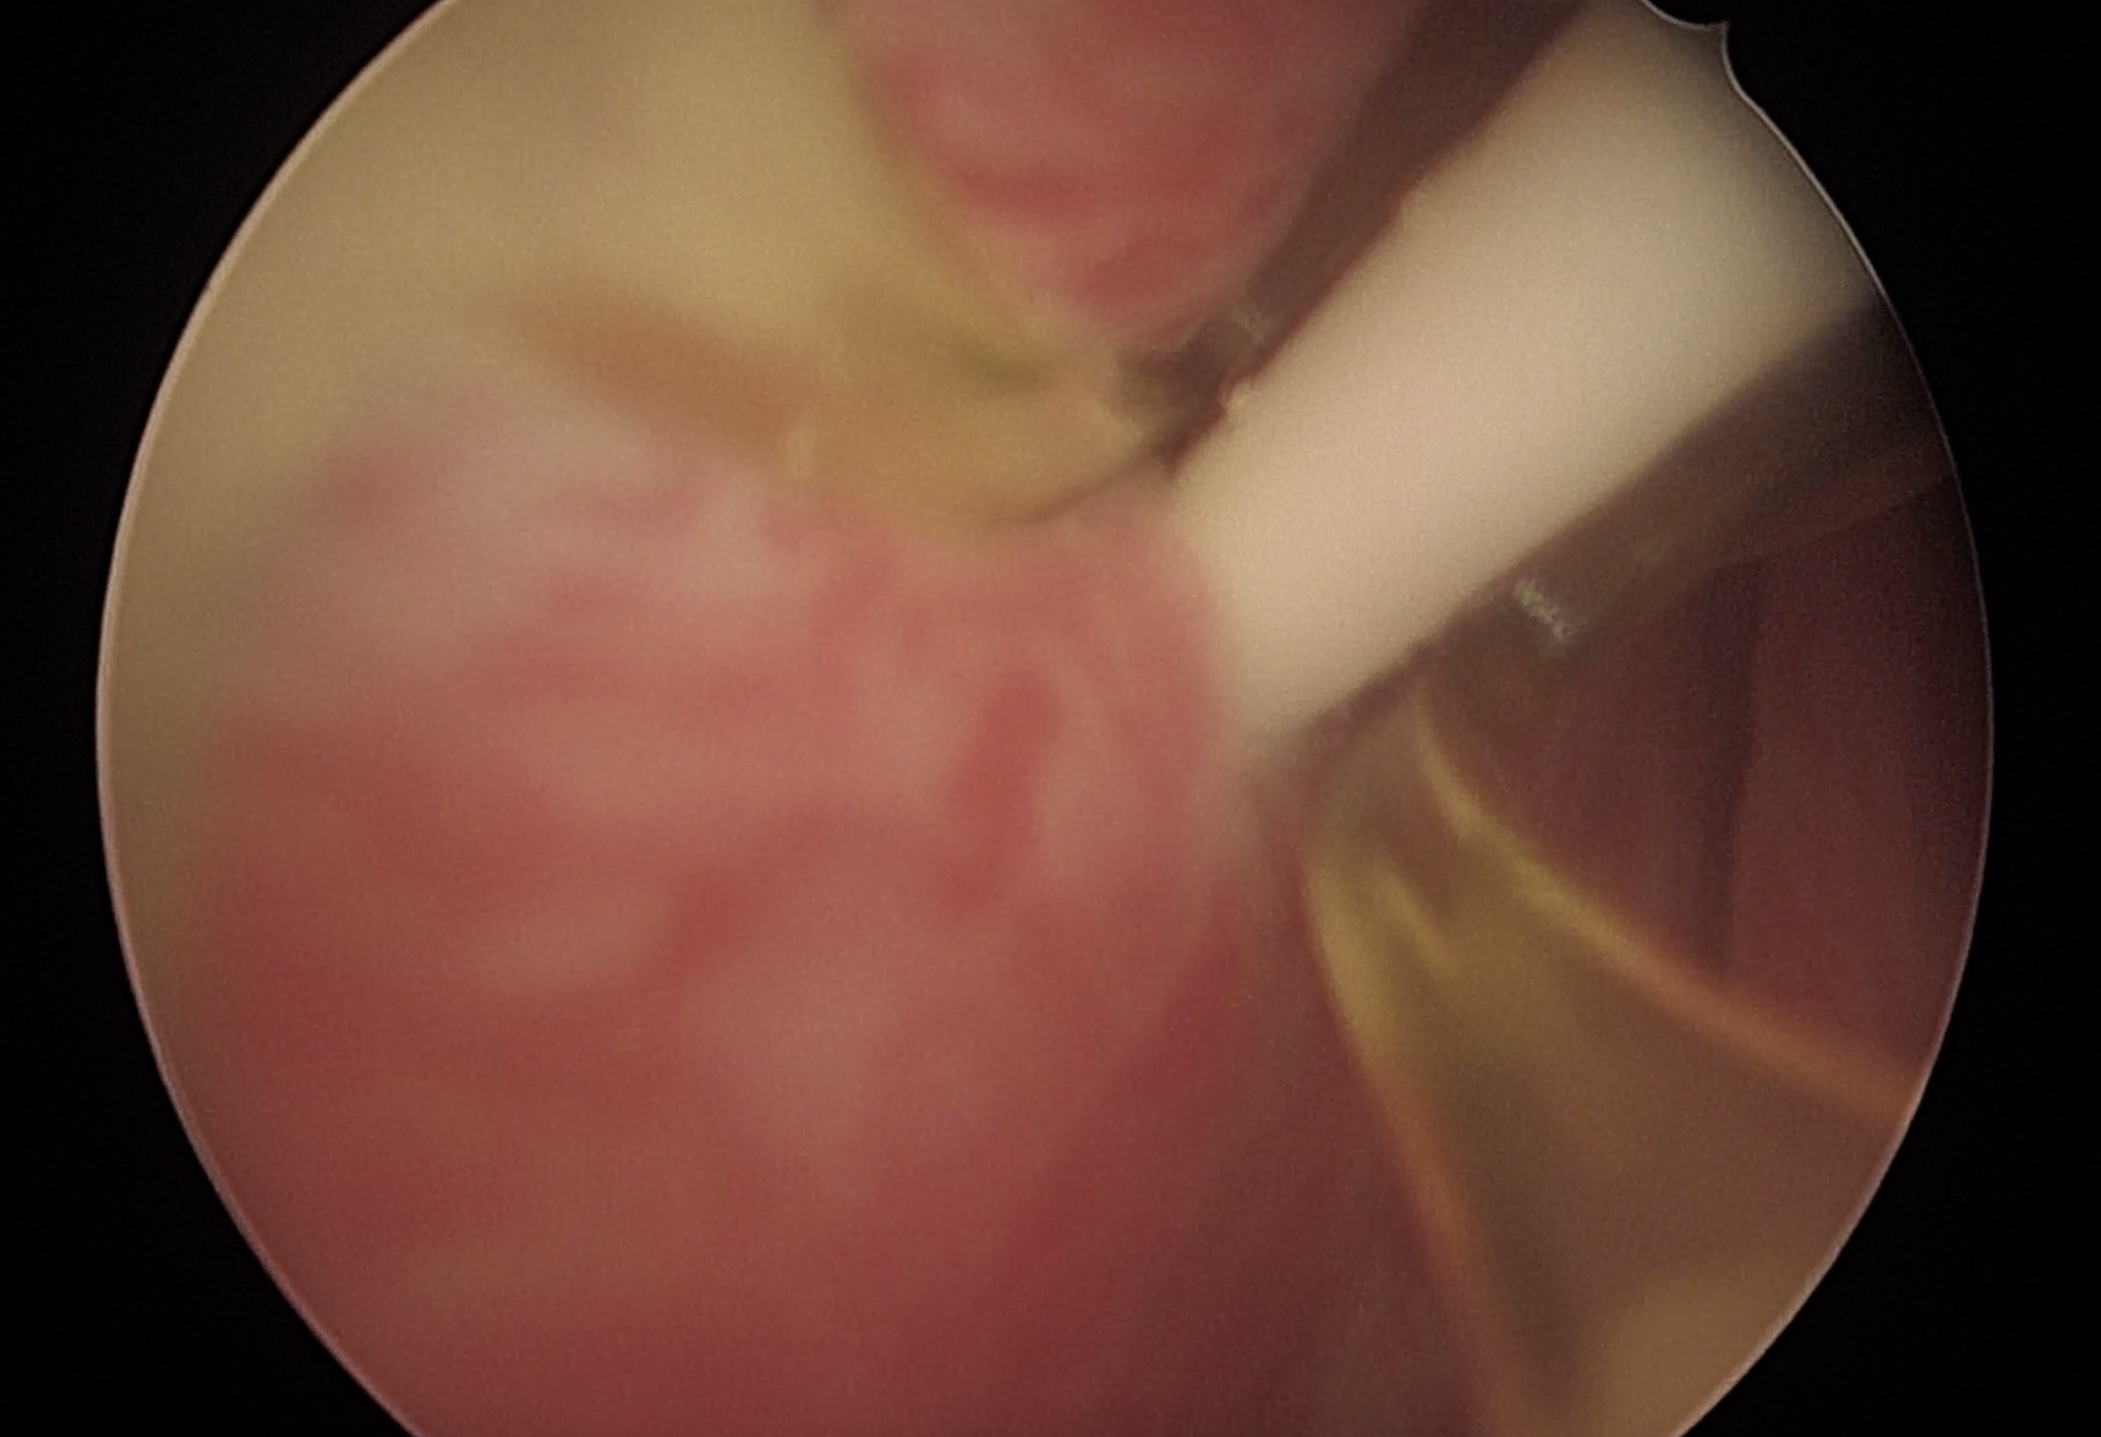
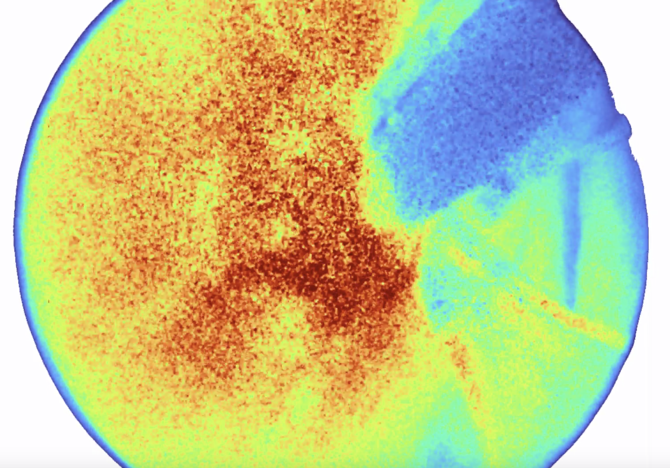
Prior to Water Vapor Treatment
White Light
Water Vapor Treatment in Real Time

Slide 12
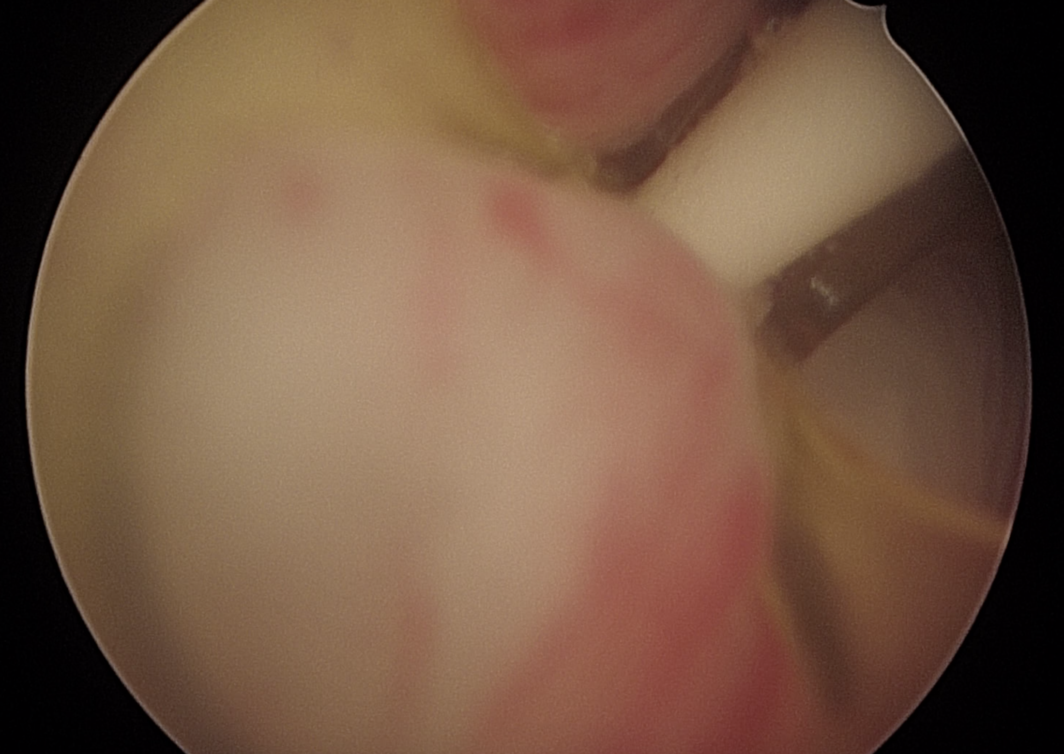
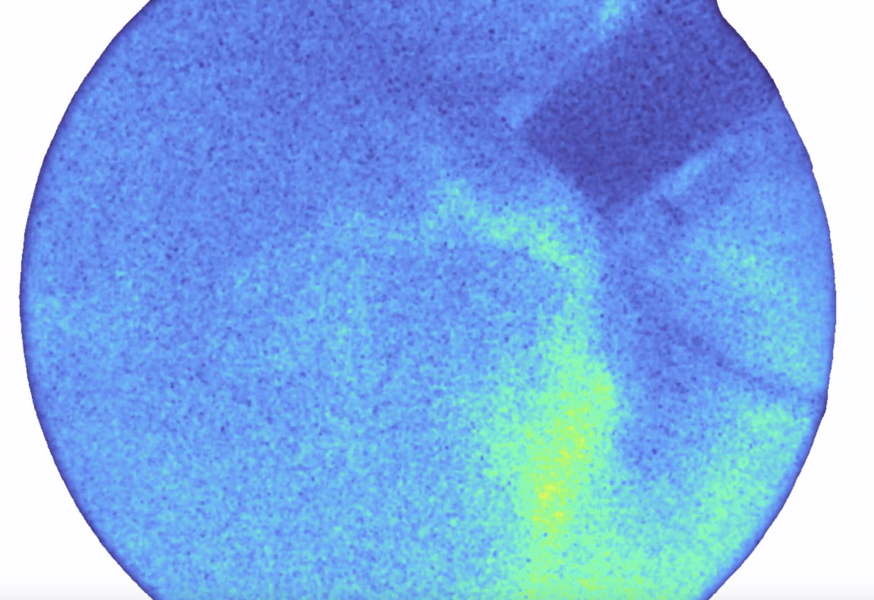
Post Water Vapor Treatment
White Light
Superficial Perfusion

Slide 13
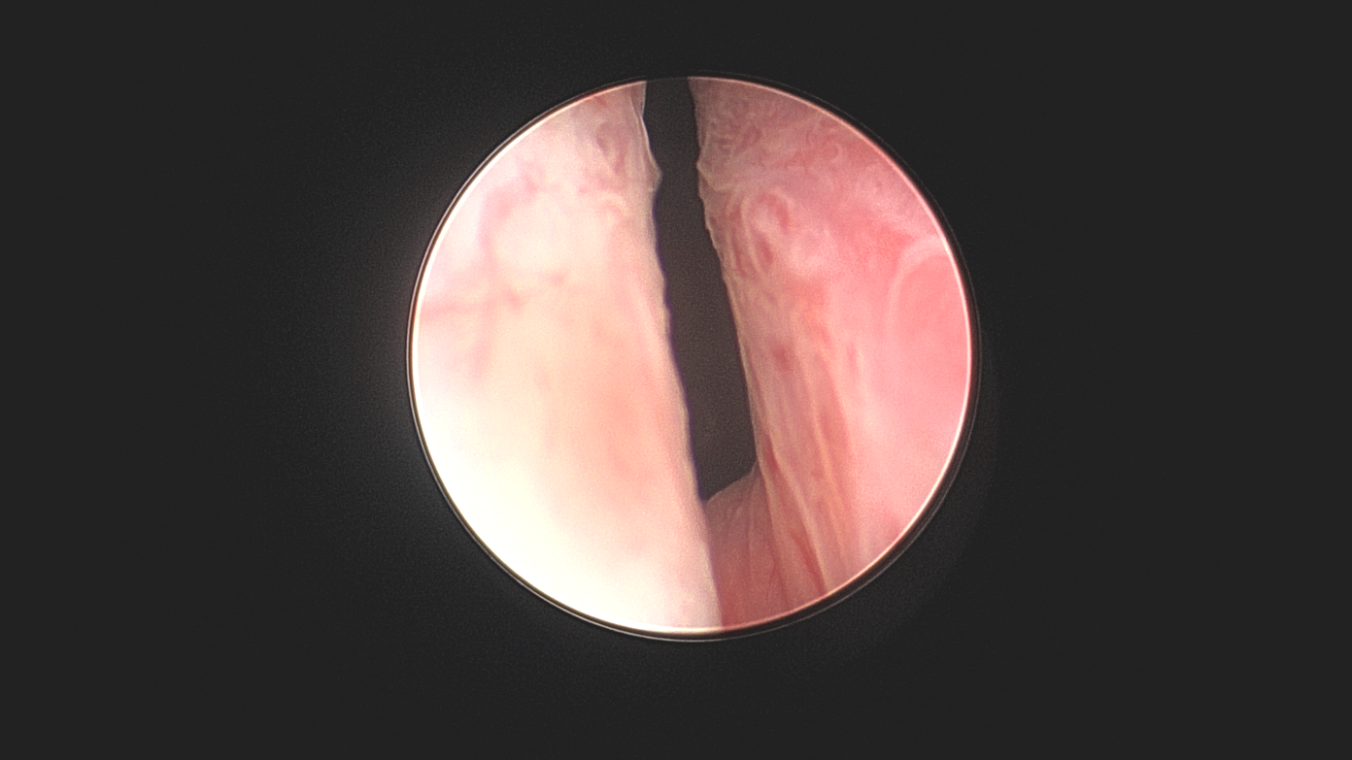
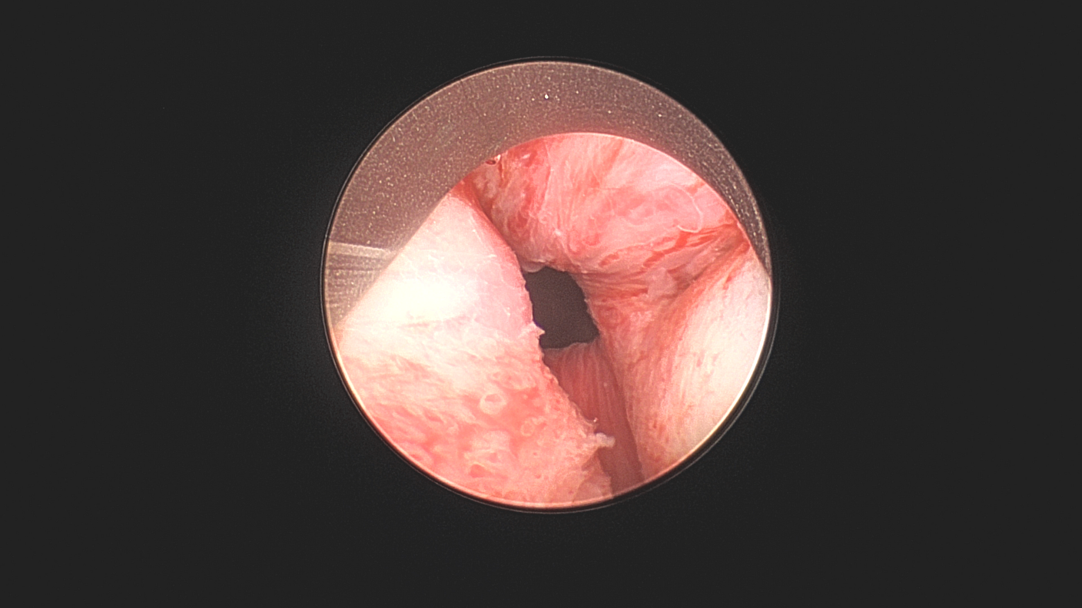
Prostatic Urethral Lift
Stitches to move tissue to the sides
Prior to treatment
One stitch placed

Slide 14
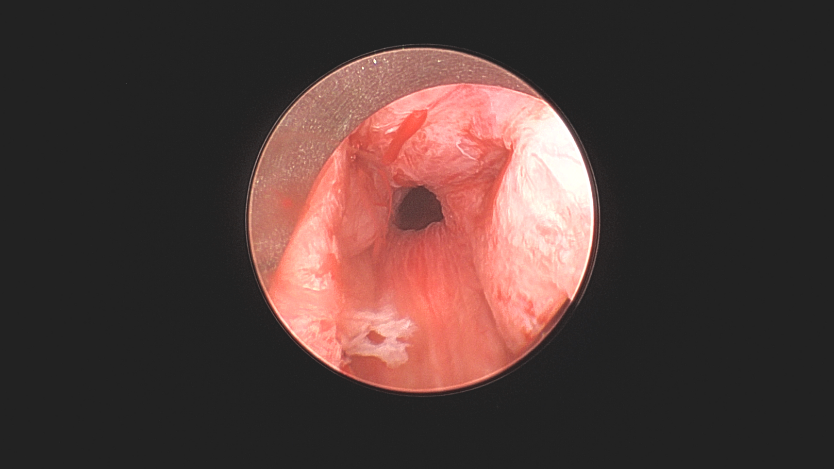
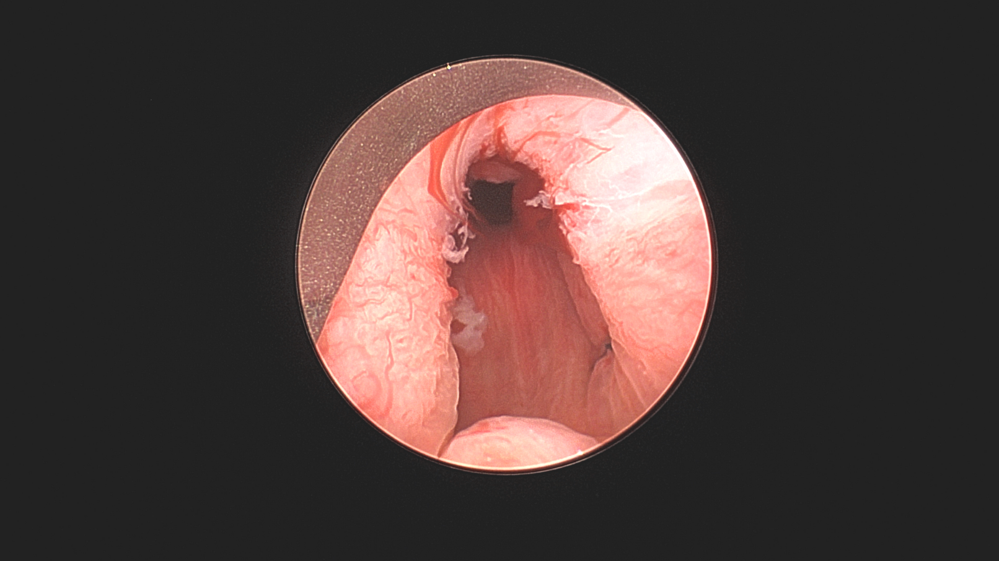
All Stitches Placed
view inside prostatic fossa
All Stitches Placed
view outside prostatic fossa

